Slide 1

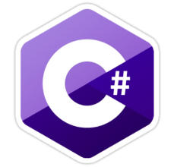
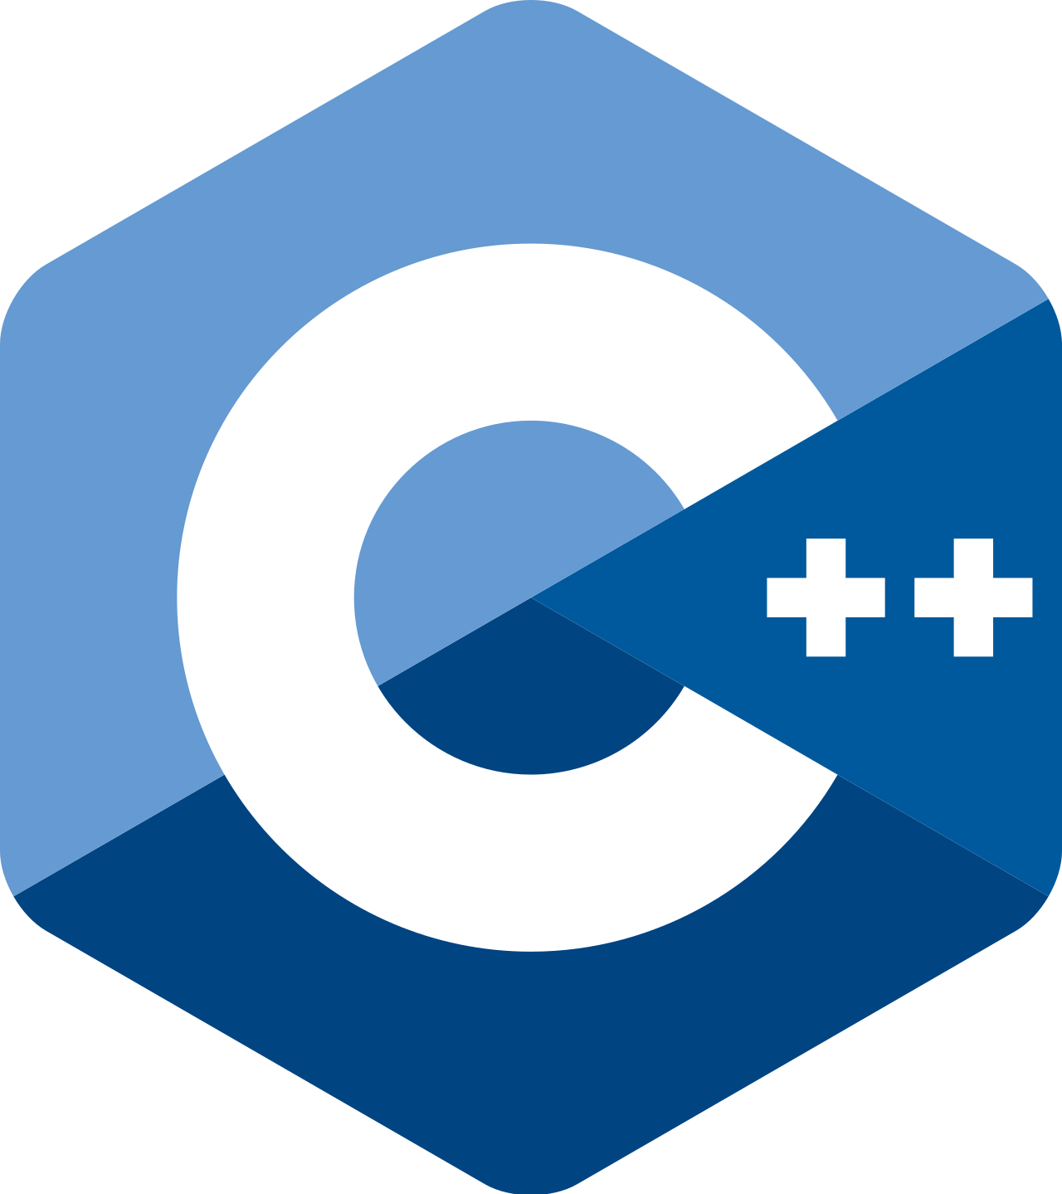
Module 4 – Part 2
Ps
1D Arrays and Lots of Brackets

Slide 2
Motivation
Problem: store five integer numbers.
Solution: create five variables!
CREATE number1 ← 10 CREATE number2 ← 20 CREATE number3 ← 30 CREATE number4 ← 40 CREATE number5 ← 50
PRINT("number1: ", number1) PRINT("number2: ", number2) PRINT("number3: ", number3) PRINT("number4: ", number4) PRINT("number5: ", number5)
What if we want 5,000,000? USE AN ARRAY!

Slide 3
Topics
Arrays and Their Properties
Creating Arrays and Initializing Arrays
Accessing Array Elements
Modifying Array Elements
Loops and Arrays

Slide 4
1. Arrays and Their Properties
Hold several values of the same type (homogeneous)
Instant access by specifying a slot number (called an index number) using brackets [ ]
Linear (one after the other)
Static – once their size is set, it’s set…
Clearly, this is a complex data type

Slide 5
What arrays “look like”
Things to notice:
There are 7 slots/cells, with index numbers 0 – 6
The name of the array is myArray
Easy to be off by one (we start with 0)
0
1
2
3
4
5
6
myArray

Slide 6
2. Creating and Initializing Arrays
You must choose:
1) Create an empty arrays and assign initial values with a loop later on:
CREATE myArray[5]
OR
2) Create and initialize the array in one line. This is helpful when we already know those value (e.g. days of the week, etc.).

Slide 7
Array Creation Example
1) Create an empty array. By default, 0s are stored in the array.
int[] myArray = new int[5];
2) Creates and initializes in one line. The stored values are show in { }; int[] myArray = {10, 20, 30, 40, 50};

Slide 8
Array Creation Example
1) Create an empty array. By default, leftover random values are stored in the array.
int size = 5; //so we know the size
int myArray[size];
2) Creates and initializes in one line. The stored values are show in { }; int myArray[5] = {10, 20, 30, 40, 50};

Slide 9
3. Accessing Information
Copy information out of a particular slot
Example:
CREATE clientAge // Integer
clientAge ← myArray[4]
This copies information from the fifth slot (index four) into the variable clientAge

Slide 10
4. Initializing a Single Cell
You must specify which index you are putting information in
Example:
CREATE myArray[50]
myArray[3] ← 12
This WILL NOT work:
CREATE myArray[50]
myArray ← 12
Data type on the left of ← is an array
Data type on right of ← is an int
Common error for students
0
1
2
3
4
49
…
12
Ps

Slide 11
Horrible, but works…
// creates empty array with 5 slots, 0-4 CREATE myArray [5] //Assigns literal values to each index in the array. myArray[0] ← 10
myArray[1] ← 20
myArray[2] ← 30
myArray[3] ← 40
myArray[4] ← 50
Ps

Slide 12
Accessing and Modifying
//Accessing int secondNumber = myArray[1]; PRINT(secondNumber);
//Modifying myArray[3] = 42; PRINT(myArray[3]);

Slide 13
Traversing the Array
You will use a loop to visit every cell of the array
Problem: create an array of 5 bytes and fill each slot with the number 42
Solution:
CREATE myArray[5]
FOR i ← 0 to 4
myArray[i] ← 42
END FOR
Ps

Slide 14
Line by Line
CREATE myArray[5]
FOR i ← 0 to 4
myArray[i] ← 42
END FOR
Ps

Slide 15
Line by Line
CREATE myArray[5]
FOR i ← 0 to 4
myArray[i] ← 42
END FOR
0
1
2
3
4
0
0
0
0
0
Ps

Slide 16
Line by Line
CREATE myArray[5]
FOR i ← 0 to 4
myArray[i] ← 42
END FOR
i
0
0
1
2
3
4
0
0
0
0
0
Ps

Slide 17
Line by Line
CREATE myArray[5]
FOR i ← 0 to 4
myArray[i] ← 42
END FOR
i
0
0
1
2
3
4
0
0
0
0
0
Ps

Slide 18
Line by Line
CREATE myArray[5]
FOR i ← 0 to 4
myArray[i] ← 42
END FOR
i
0
0
1
2
3
4
0
0
0
0
0
Ps

Slide 19
Line by Line
CREATE myArray[5]
FOR i ← 0 to 4
myArray[i] ← 42
END FOR
i
0
0
1
2
3
4
42
0
0
0
0
Ps

Slide 20
Line by Line
CREATE myArray[5]
FOR i ← 0 to 4
myArray[i] ← 42
END FOR
i
0
0
1
2
3
4
42
0
0
0
0
Ps

Slide 21
Line by Line
CREATE myArray[5]
FOR i ← 0 to 4
myArray[i] ← 42
END FOR
i
1
0
1
2
3
4
42
0
0
0
0
Ps

Slide 22
Line by Line
CREATE myArray[5]
FOR i ← 0 to 4
myArray[i] ← 42
END FOR
i
1
0
1
2
3
4
42
0
0
0
0
Ps

Slide 23
Line by Line
CREATE myArray[5]
FOR i ← 0 to 4
myArray[i] ← 42
END FOR
i
1
0
1
2
3
4
42
42
0
0
0
Ps

Slide 24
Line by Line
CREATE myArray[5]
FOR i ← 0 to 4
myArray[i] ← 42
END FOR
i
1
0
1
2
3
4
42
42
0
0
0
Ps

Slide 25
Line by Line
CREATE myArray[5]
FOR i ← 0 to 4
myArray[i] ← 42
END FOR
i
2
0
1
2
3
4
42
42
0
0
0
Ps

Slide 26
Line by Line
CREATE myArray[5]
FOR i ← 0 to 4
myArray[i] ← 42
END FOR
i
2
0
1
2
3
4
42
42
0
0
0
Ps

Slide 27
Line by Line
CREATE myArray[5]
FOR i ← 0 to 4
myArray[i] ← 42
END FOR
i
2
0
1
2
3
4
42
42
42
0
0
Ps

Slide 28
Line by Line
CREATE myArray[5]
FOR i ← 0 to 4
myArray[i] ← 42
END FOR
i
2
0
1
2
3
4
42
42
42
0
0
Ps

Slide 29
Line by Line
CREATE myArray[5]
FOR i ← 0 to 4
myArray[i] ← 42
END FOR
i
3
0
1
2
3
4
42
42
42
0
0
Ps

Slide 30
Line by Line
CREATE myArray[5]
FOR i ← 0 to 4
myArray[i] ← 42
END FOR
i
3
0
1
2
3
4
42
42
42
0
0
Ps

Slide 31
Line by Line
CREATE myArray[5]
FOR i ← 0 to 4
myArray[i] ← 42
END FOR
i
3
0
1
2
3
4
42
42
42
42
0
Ps

Slide 32
Line by Line
CREATE myArray[5]
FOR i ← 0 to 4
myArray[i] ← 42
END FOR
i
3
0
1
2
3
4
42
42
42
42
0
Ps

Slide 33
Line by Line
CREATE myArray[5]
FOR i ← 0 to 4
myArray[i] ← 42
END FOR
i
4
0
1
2
3
4
42
42
42
42
0
Ps

Slide 34
Line by Line
CREATE myArray[5]
FOR i ← 0 to 4
myArray[i] ← 42
END FOR
i
4
0
1
2
3
4
42
42
42
42
0
Ps

Slide 35
Line by Line
CREATE myArray[5]
FOR i ← 0 to 4
myArray[i] ← 42
END FOR
i
4
0
1
2
3
4
42
42
42
42
42
Ps

Slide 36
Line by Line
CREATE myArray[5]
FOR i ← 0 to 4
myArray[i] ← 42
END FOR
i
4
0
1
2
3
4
42
42
42
42
42
Ps

Slide 37
Line by Line
CREATE myArray[5]
FOR i ← 0 to 4
myArray[i] ← 42
END FOR
i
5
0
1
2
3
4
42
42
42
42
42
Ps

Slide 38
Line by Line
false
CREATE myArray[5]
FOR i ← 0 to 4
myArray[i] ← 42
END FOR
i
5
0
1
2
3
4
42
42
42
42
42
Ps

Slide 39
The Length of an Array
Most languages have either a:
Length attribute; OR
Length method
C++ does not have either, you must declare a size variable and use it to initialize your array
So, loop from 0 to the array’s length
Let’s see an exciting example!

Slide 40
Traversing an Array
Use a FOR, WHILE or DO-WHILE starting at index 0
and going thru length (<) or length-1 (<=)
for (int i=0; i < data_storage.length; i++)
{ // do something }
OR use a foreach loop
for (int t : data_storage)
{ //do something, but not assignment!
}

Slide 41
Traversing an Array
Use a FOR, WHILE or DO-WHILE starting at index 0
and going thru length (<) or length-1 (<=)
for (int i=0; i < data_storage.Length; i++)
{ // do something }
OR use a foreach loop
foreach (Trophy t in data_storage)
{ // do something as long as it is not assignment
}
// We told you it was exciting

Slide 42
Traversing an Array
Use a FOR, WHILE or DO-WHILE starting at index 0
and going thru size (<) or size (<=), size is a variable used to declare the length of the array.
for (int i=0; i < size; i++)
{ // do something }
OR use a foreach loop
for (int t : data_storage)
{ // do something as long as it is not assignment
}
// We told you it was exciting

Slide 43
Array Processing
The simplest processes involve finding a sum, product or average of the array.
You also need to know how to:
Search (finding a value, the largest or smallest )
Sort (alphabetically or numerically) in increasing and decreasing order. This will be covered in Module 8.

Slide 44
Example: Finding the Smallest Element
If you were given an array of numbers, how would YOU do it?
Computers can only compare two at a time
Go through entire list
Keep track of smallest so far
Let’s assume
We have an array of 5 ints
The array contains random unknown numbers
The name of the array is called randomArray

Slide 45
Another Trace
Ps
CREATE smallestSoFar
smallestSoFar ← randomArray[0]
FOR counter ← 1 to 4
IF (smallestSoFar > randomArray[counter]) THEN
smallestSoFar ← randomArray[counter]
END IF
END FOR
0
1
2
3
4
smallestSoFar
42
17
42
-8
4

Slide 46
Another Trace
Ps
CREATE smallestSoFar
smallestSoFar ← randomArray[0] // Init smallestSoFar
FOR counter ← 1 to 4
IF (smallestSoFar > randomArray[counter]) THEN
smallestSoFar ← randomArray[counter]
END IF
END FOR
0
1
2
3
4
smallestSoFar
42
17
42
-8
4

Slide 47
Another Trace
Ps
CREATE smallestSoFar
smallestSoFar ← randomArray[0] // Now 42
FOR counter ← 1 to 4
IF (smallestSoFar > randomArray[counter]) THEN
smallestSoFar ← randomArray[counter]
END IF
END FOR
0
1
2
3
4
smallestSoFar
42
17
42
-8
4
42

Slide 48
Another Trace
Ps
CREATE smallestSoFar
smallestSoFar ← randomArray[0]
FOR counter ← 1 to 4 // why 1 instead of 0?
IF (smallestSoFar > randomArray[counter]) THEN
smallestSoFar ← randomArray[counter]
END IF
END FOR
counter
1
0
1
2
3
4
smallestSoFar
42
17
42
-8
4
42

Slide 49
Another Trace
Ps
CREATE smallestSoFar
smallestSoFar ← randomArray[0]
FOR counter ← 1 to 4
IF (smallestSoFar > randomArray[counter]) THEN
smallestSoFar ← randomArray[counter]
END IF
END FOR
Is 42 > 17?
counter
1
0
1
2
3
4
smallestSoFar
42
17
42
-8
4
42

Slide 50
Another Trace
Ps
CREATE smallestSoFar
smallestSoFar ← randomArray[0]
FOR counter ← 1 to 4
IF (smallestSoFar > randomArray[counter]) THEN
smallestSoFar ← randomArray[counter] // Update!!
END IF
END FOR
counter
1
0
1
2
3
4
smallestSoFar
42
17
42
-8
4
17

Slide 51
Another Trace
Ps
CREATE smallestSoFar
smallestSoFar ← randomArray[0]
FOR counter ← 1 to 4
IF (smallestSoFar > randomArray[counter]) THEN
smallestSoFar ← randomArray[counter]
END IF
END FOR
counter
1
0
1
2
3
4
smallestSoFar
42
17
42
-8
4
17

Slide 52
Another Trace
Ps
CREATE smallestSoFar
smallestSoFar ← randomArray[0]
FOR counter ← 1 to 4
IF (smallestSoFar > randomArray[counter]) THEN
smallestSoFar ← randomArray[counter]
END IF
END FOR // Back to the top
counter
1
0
1
2
3
4
smallestSoFar
42
17
42
-8
4
17

Slide 53
Another Trace
Ps
CREATE smallestSoFar
smallestSoFar ← randomArray[0]
FOR counter ← 1 to 4 // increment to 2
IF (smallestSoFar > randomArray[counter]) THEN
smallestSoFar ← randomArray[counter]
END IF
END FOR
counter
2
0
1
2
3
4
smallestSoFar
42
17
42
-8
4
17

Slide 54
Another Trace
Ps
CREATE smallestSoFar
smallestSoFar ← randomArray[0]
FOR counter ← 1 to 4
IF (smallestSoFar > randomArray[counter]) THEN
smallestSoFar ← randomArray[counter]
END IF
END FOR
Is 17 > 42?
counter
2
0
1
2
3
4
smallestSoFar
42
17
42
-8
4
17

Slide 55
Another Trace
Ps
CREATE smallestSoFar
smallestSoFar ← randomArray[0]
FOR counter ← 1 to 4
IF (smallestSoFar > randomArray[counter]) THEN
smallestSoFar ← randomArray[counter]
END IF // Nope. Skip updating
END FOR
counter
2
0
1
2
3
4
smallestSoFar
42
17
42
-8
4
17

Slide 56
Another Trace
Ps
CREATE smallestSoFar
smallestSoFar ← randomArray[0]
FOR counter ← 1 to 4
IF (smallestSoFar > randomArray[counter]) THEN
smallestSoFar ← randomArray[counter]
END IF
END FOR // Back to the top
counter
3
0
1
2
3
4
smallestSoFar
42
17
42
-8
4
17

Slide 57
Another Trace
Ps
CREATE smallestSoFar
smallestSoFar ← randomArray[0]
FOR counter ← 1 to 4 // increment to 3
IF (smallestSoFar > randomArray[counter]) THEN
smallestSoFar ← randomArray[counter]
END IF
END FOR
counter
3
0
1
2
3
4
smallestSoFar
42
17
42
-8
4
17

Slide 58
Another Trace
Ps
CREATE smallestSoFar
smallestSoFar ← randomArray[0]
FOR counter ← 1 to 4
IF (smallestSoFar > randomArray[counter]) THEN
smallestSoFar ← randomArray[counter]
END IF
END FOR
Is 17 > -8?
counter
3
0
1
2
3
4
smallestSoFar
42
17
42
-8
4
17

Slide 59
Another Trace
Ps
CREATE smallestSoFar
smallestSoFar ← randomArray[0]
FOR counter ← 1 to 4
IF (smallestSoFar > randomArray[counter]) THEN
smallestSoFar ← randomArray[counter] // Update!!
END IF
END FOR
counter
3
0
1
2
3
4
smallestSoFar
42
17
42
-8
4
-8

Slide 60
Note!
We’ve found the smallest in the array
Does the computer know that?
What happens next (and why)?

Slide 61
Another Trace
Ps
CREATE smallestSoFar
smallestSoFar ← randomArray[0]
FOR counter ← 1 to 4
IF (smallestSoFar > randomArray[counter]) THEN
smallestSoFar ← randomArray[counter]
END IF
END FOR
counter
3
0
1
2
3
4
smallestSoFar
42
17
42
-8
4
-8

Slide 62
Another Trace
Ps
CREATE smallestSoFar
smallestSoFar ← randomArray[0]
FOR counter ← 1 to 4
IF (smallestSoFar > randomArray[counter]) THEN
smallestSoFar ← randomArray[counter]
END IF
END FOR // Back to the top
counter
3
0
1
2
3
4
smallestSoFar
42
17
42
-8
4
-8

Slide 63
Another Trace
Ps
CREATE smallestSoFar
smallestSoFar ← randomArray[0]
FOR counter ← 1 to 4 // increment to 4
IF (smallestSoFar > randomArray[counter]) THEN
smallestSoFar ← randomArray[counter]
END IF
END FOR
counter
4
0
1
2
3
4
smallestSoFar
42
17
42
-8
4
-8

Slide 64
Another Trace
Ps
CREATE smallestSoFar
smallestSoFar ← randomArray[0]
FOR counter ← 1 to 4
IF (smallestSoFar > randomArray[counter]) THEN
smallestSoFar ← randomArray[counter]
END IF
END FOR
Is -8 > 4?
counter
4
0
1
2
3
4
smallestSoFar
42
17
42
-8
4
-8

Slide 65
Another Trace
Ps
CREATE smallestSoFar
smallestSoFar ← randomArray[0]
FOR counter ← 1 to 4
IF (smallestSoFar > randomArray[counter]) THEN
smallestSoFar ← randomArray[counter]
END IF // No update happened
END FOR
counter
4
0
1
2
3
4
smallestSoFar
42
17
42
-8
4
-8

Slide 66
Another Trace
Ps
CREATE smallestSoFar
smallestSoFar ← randomArray[0]
FOR counter ← 1 to 4
IF (smallestSoFar > randomArray[counter]) THEN
smallestSoFar ← randomArray[counter]
END IF
END FOR // Back to the top
counter
4
0
1
2
3
4
smallestSoFar
42
17
42
-8
4
-8

Slide 67
Another Trace
Ps
CREATE smallestSoFar
smallestSoFar ← randomArray[0]
FOR counter ← 1 to 4 // increment to 5
IF (smallestSoFar > randomArray[counter]) THEN
smallestSoFar ← randomArray[counter]
END IF
END FOR
counter
5
0
1
2
3
4
smallestSoFar
42
17
42
-8
4
-8

Slide 68
Another Trace
Ps
CREATE smallestSoFar
smallestSoFar ← randomArray[0]
FOR counter ← 1 to 4
IF (smallestSoFar > randomArray[counter]) THEN
smallestSoFar ← randomArray[counter]
END IF
END FOR
// Done
counter
5
0
1
2
3
4
smallestSoFar
42
17
42
-8
4
-8

Slide 69
Finding the Minimum using a Method
int temp = A[0];
for (int i = 1; i < A.length; i++) {
if (temp > A[i]) {
temp = A[i];
}
}
Parameters match in position and type, so the name doesn't matter. Arrays are a reference type in Java.

Slide 70
Finding the Minimum using a Method
int temp = A[0];
for (int i = 1; i < A.Length; i++) {
if (temp > A[i]) {
temp = A[i];
}
}
Parameters match in position and type, so the name doesn't matter. Arrays are a reference type in C#.

Slide 71
Finding the Minimum using a Method
int temp = A[0];
for (int i = 1; i < 150; i++) {
if (temp > A[i]) {
temp = A[i];
}
}
No length attribute in C++.

Slide 72
Finding the sum or average using a method
CREATE sum, average
BEGIN
sum ← 0
FOR i ← 0 to nums.length - 1 // MOST IMPORTANT LINE IS HERE
sum = sum + nums[i]
ENDFOR
average = sum / nums.length
END
Ps

Slide 73
Finding a sum and or average using a method
int sum = 0;
for (int i = 0; i < B.length; i++)
{
sum += B[i];
}

Slide 74
Finding a sum and or average using a method
int sum = 0;
for (int i = 0; i < B.Length; i++)
{
sum += B[i];
}

Slide 75
Finding a sum and or average using a method
int sum = 0;
for (int i = 0; i < size; i++)
{
sum += B[i];
}
// where size holds the size of B

Slide 76
Summary
Arrays hold values that are all the same type
Arrays are static in size
Creating arrays always follows a format
You can create an array of any type
To initialize or search arrays, you’ll almost always use a loop

